Slide 1

Chapter 1
Introduction
Copyright © The McGraw-Hill Companies, Inc. Permission required for reproduction or display.

Slide 2
1-1 DATA COMMUNICATIONS
The term telecommunication means communication at a distance. The word data refers to information presented in whatever form is agreed upon by the parties creating and using the data. Data communications are the exchange of data between two devices via some form of transmission medium such as a wire cable.
Topics discussed in this section:
Components
Data Representation Data Flow

Slide 3
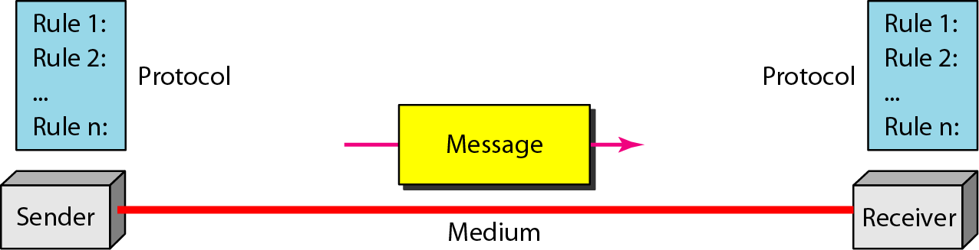
Figure 1.1 Five components of data communication

Slide 4
Data Representation
Text, numbers, images, audio, and video are different forms of Data Representation.
Text
In data communications, text is represented as a bit pattern, a sequence of bits.
Different sets of bit patterns have been designed to represent text symbols. Each set is called a code, and the process of representing symbols is called coding i.e ASCII made by ANSI, Unicode

Slide 5
Data Representation cont..
Numbers are also represented by using bit patterns. However , a code such as ASCII is not used to represent numbers; the numbers is directly converted to a binary number.
Images today are also represented by bit patterns but an image is divided in to a matrix of pixels.
Audio is a representation of sound. It is a continuous , not discrete.
Video can be produced either as a continuous entity or it can be a combination of images.

Slide 6
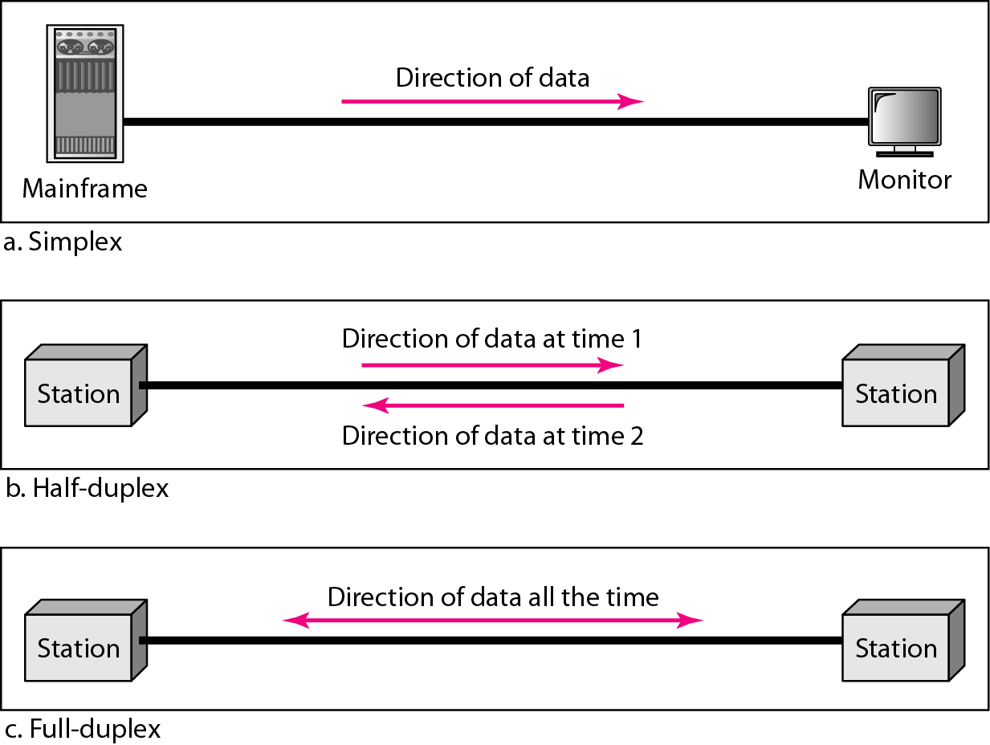
Figure 1.2 Data flow (simplex, half-duplex, and full-duplex)

Slide 7
1-2 NETWORKS
A network is a set of devices (often referred to as nodes) connected by communication links. A node can be a computer, printer, or any other device capable of sending and/or receiving data generated by other nodes on the network.
Topics discussed in this section:
Distributed Processing
Network Criteria Physical Structures Network Models Categories of Networks Interconnection of Networks: Internetwork

Slide 8
Network
A network is a set of devices (often referred to as nodes) connected by communication links.
Distributed Processing
Most Networks use distributed processing, in which a task is divided among multiple computers

Slide 9
Network Criteria
A network must be able to meet a certain number of criteria. The most important of these are
Performance
Reliability
Security

Slide 10
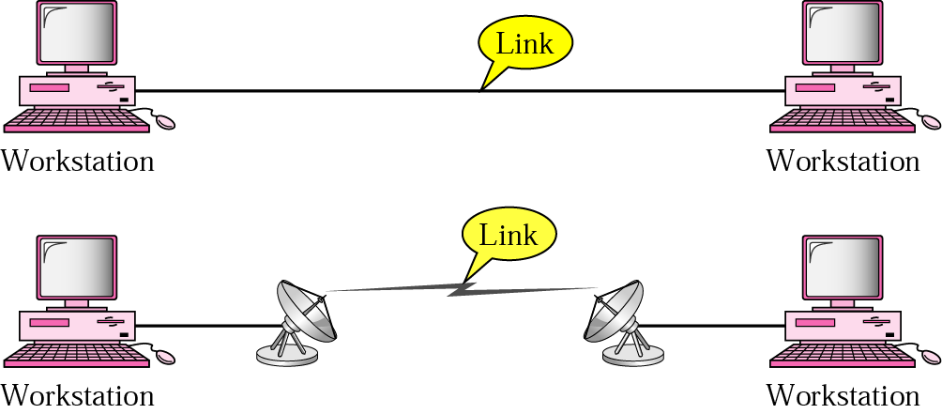
Physical Structures
Type of Connection
Physical Topology
Point-to-point connection

Slide 11
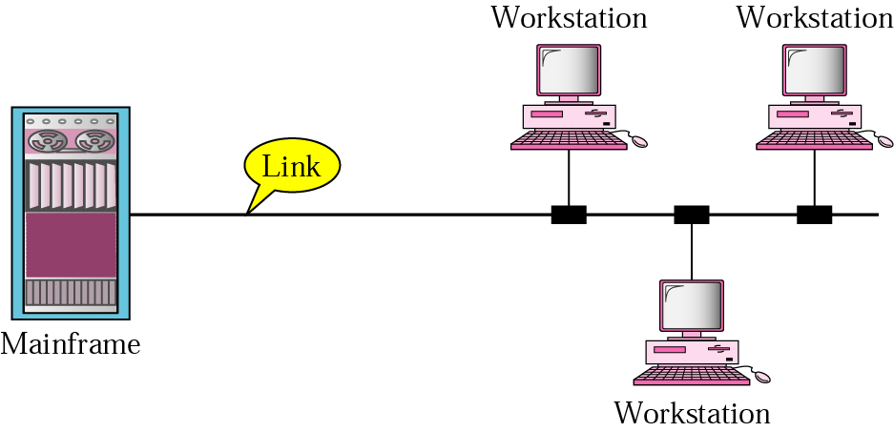
Physical Structures Cont..
Multipoint Connection

Slide 12
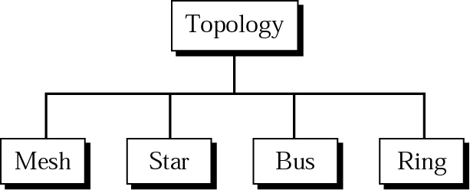
Physical topology
Topology refers to the physical or logical arrangement of a network.

Slide 13
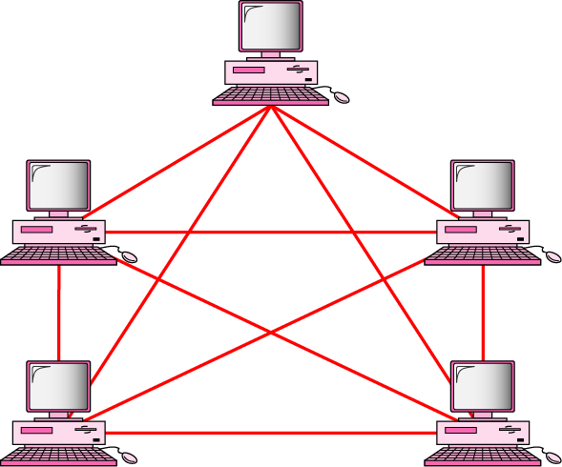
Mesh Topology
In a mesh topology, every device has a dedicated point to point link to every other device.

Slide 14
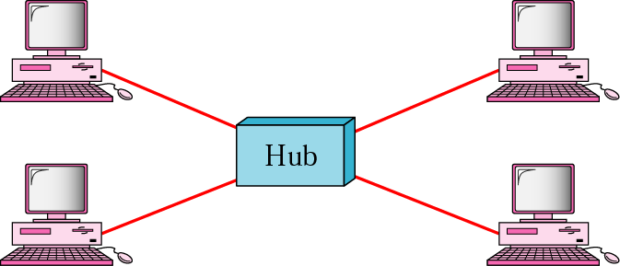
Star Topology
In a star topology, each device has a dedicated point to point link only to a central controller.

Slide 15
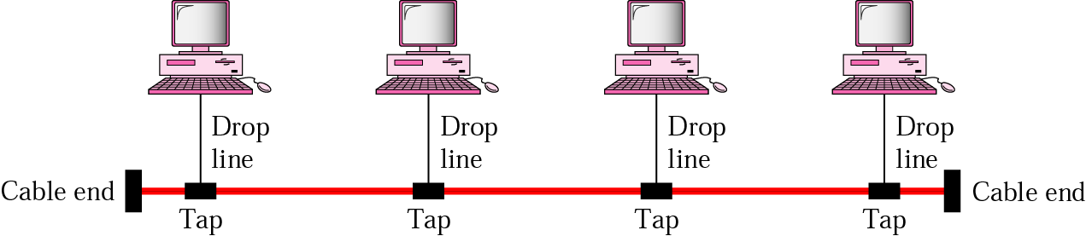
Bus Topology
A bus topology is a multipoint topology in which one long cable acts as a backbone to link all the devices in the network.

Slide 16
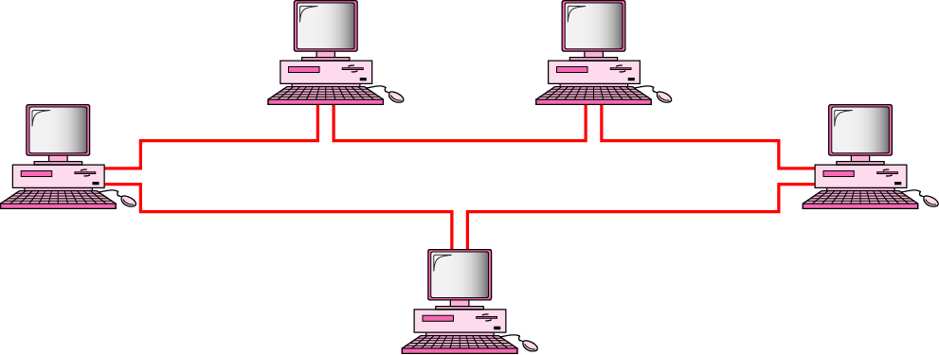
Ring topology
In a ring topology, each device has a dedicated point to point connection only with two devices on either side of it.

Slide 17
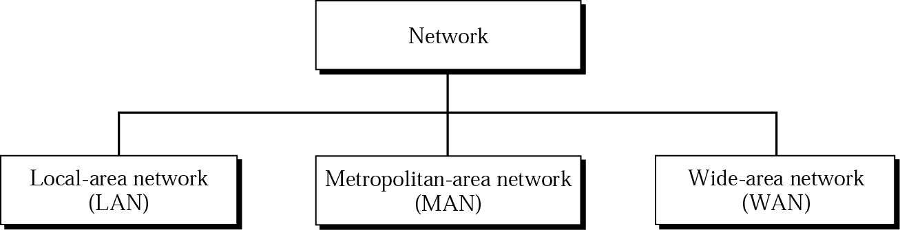
Categories of Networks

Slide 18
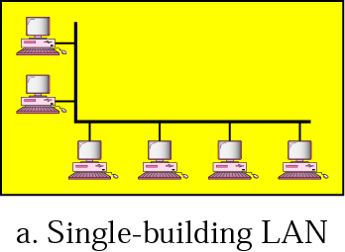
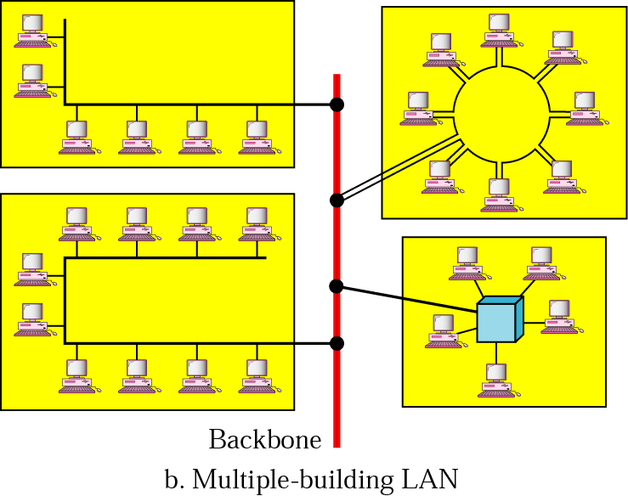
Local Area Network
A local area network is usually privately owned and links the devices in a single office, building, or campus.

Slide 19
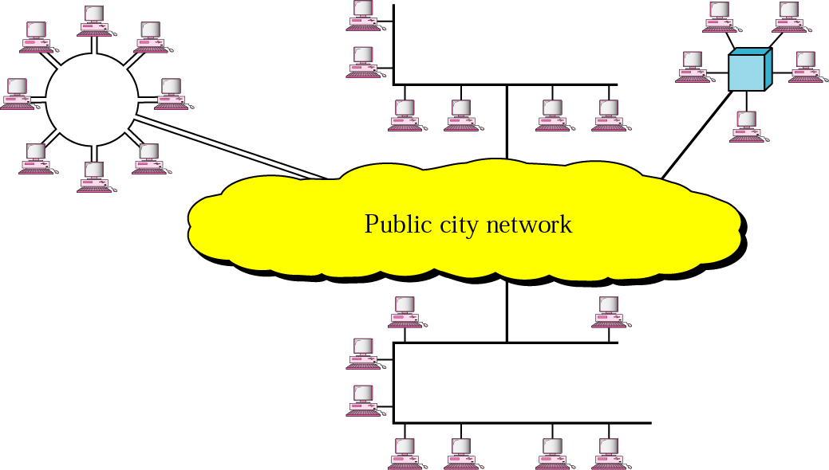
Metropolitan Area Network
A MAN is a data communication system covering an area the size of a town or city.

Slide 20
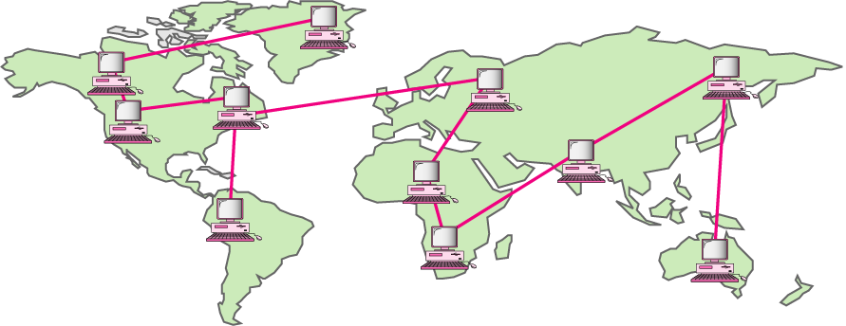
Wide Area Network
A WAN is a data communication system spanning states, countries, or the whole world.

Slide 21
WAN Implementation
Traditionally, WANs have been implemented using one of two technologies:
Circuit Switching
Packet Switching
Circuit Switching
In a circuit switching network, a dedicated communication path is established between two stations through the nodes of the network. Telephone network is a example of Circuit switching.
Packet Switching
In packet Switching it is not necessary to dedicate communication path between two stations. Data are sent out in a sequence of small chunks, called packets.

Slide 22
WAN Implementation cont…
Frame Relay
Frame Relay is also a packet switching technique with variable length packets develop to take the advantages of high data rates and low error rates of current Transmission Systems.
ATM
Asynchronous transfer mode, sometimes referred to as cell relay, is a culmination of developments in circuit switching and packet switching. ATM technology uses a fixed size packet called a cell.

Slide 23
Protocols and Standards
Protocol
A protocol is a set of rules that governs data communication;
The key elements of a protocol are Syntax, Semantics and Timing.
Syntax
Syntax refers to the structure or format of the data. For example, a simple protocol might expect the first 8 bits of data to be the address of the sender, the second 8 bits to be the address of the receiver, and the rest of the stream to the message itself.
Semantics
Semantics refers to the meaning of each section of bits. For example, does an address identify the route to be taken or the final destination of the message?
Timing
Timing refers to two characteristics: when data should be sent and how fast they can be sent.

Slide 24
Protocols and Standards
Standards
Standards are necessary to ensure that products from different manufactures can work together as expected.
Data communication Standards fall in to two categories: de facto and de jure
De facto
Meaning by fact, standards that have not been approved by an organized body but have been adopted as standards through widespread, Often established originally by manufactures that seek to define the functionality of a new product or technology.
De jure
Those that have been legislated by an officially recognized body.

Slide 25
Standards Organizations
International Organization for Standardization (ISO)
International Telecommunication Union-Telecommunication Standards (ITU-T)
American National Standards Institute (ANSI)
Institute of Electrical and Electronics Engineers (IEEE)
Electronic Industries Association (EIA)

Slide 26
Chapter 2
Network Models
Copyright © The McGraw-Hill Companies, Inc. Permission required for reproduction or display.

Slide 27
2-1 LAYERED TASKS
We use the concept of layers in our daily life. As an example, let us consider two friends who communicate through postal mail. The process of sending a letter to a friend would be complex if there were no services available from the post office.
Topics discussed in this section:
Sender, Receiver, and Carrier Hierarchy

Slide 28
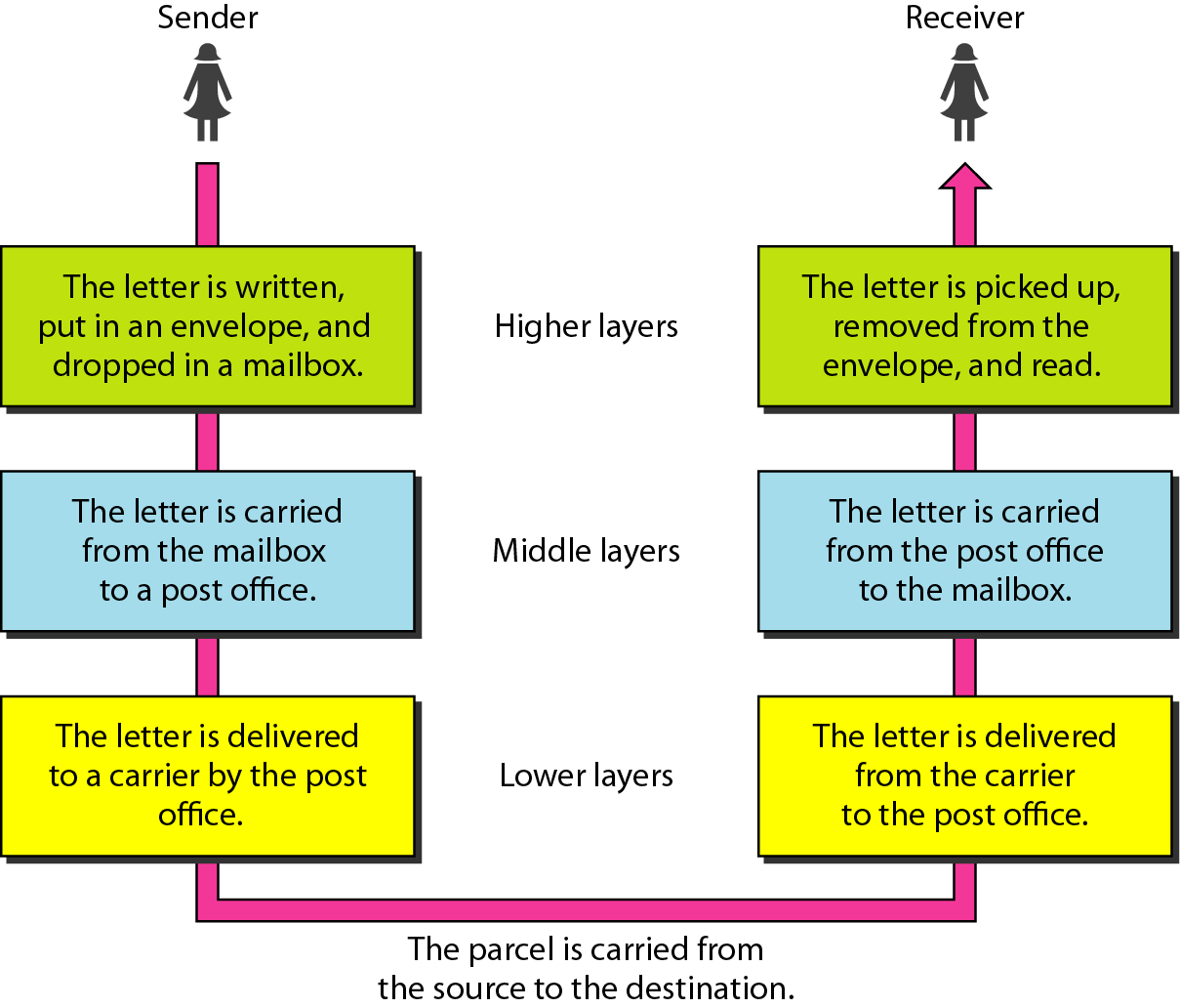
Figure 2.1 Tasks involved in sending a letter

Slide 29
2-2 THE OSI MODEL
Established in 1947, the International Standards Organization (ISO) is a multinational body dedicated to worldwide agreement on international standards. An ISO standard that covers all aspects of network communications is the Open Systems Interconnection (OSI) model. It was first introduced in the late 1970s.
Topics discussed in this section:
Layered Architecture Peer-to-Peer Processes
Encapsulation

Slide 30

Note
ISO is the organization. OSI is the model.

Slide 31
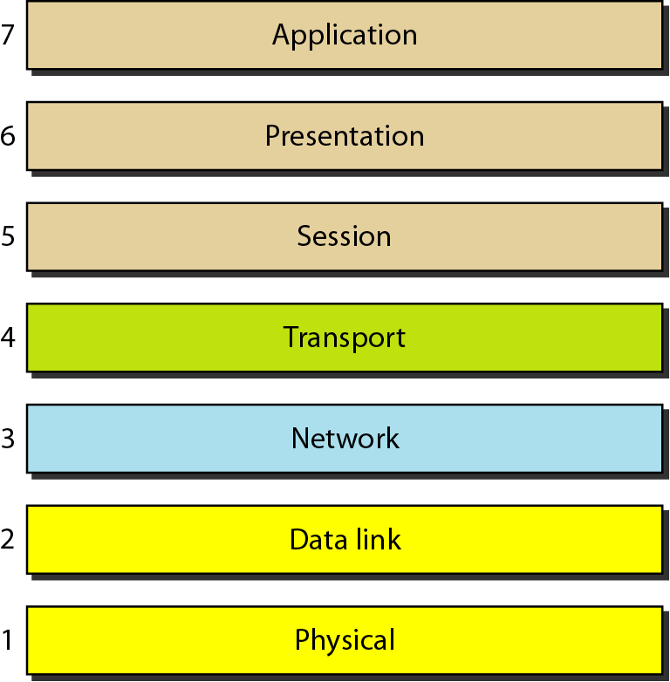
Figure 2.2 Seven layers of the OSI model

Slide 32
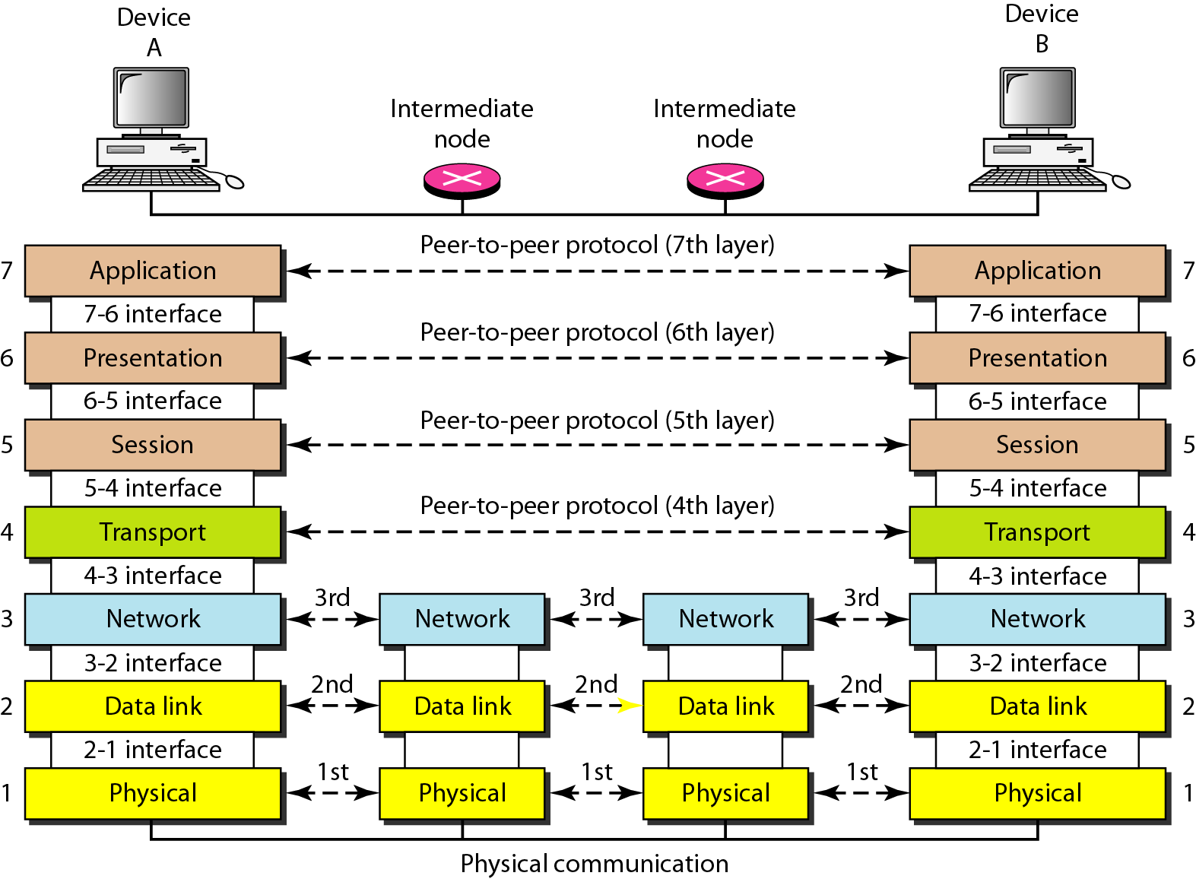
Figure 2.3 The interaction between layers in the OSI model

Slide 33
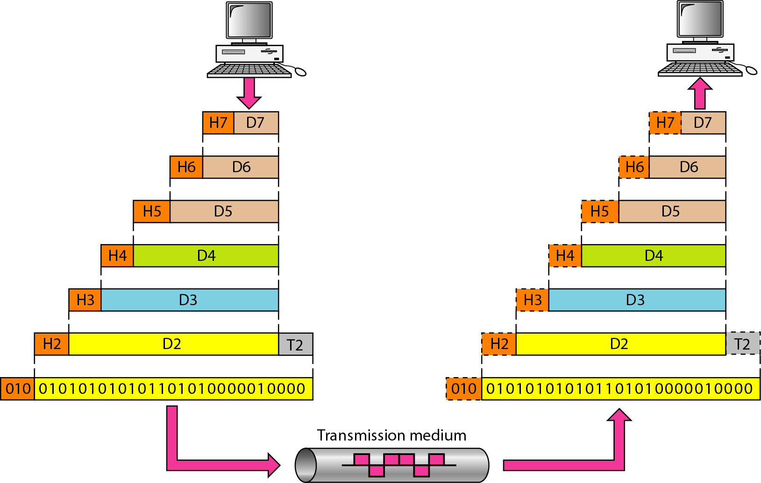
Figure 2.4 An exchange using the OSI model

Slide 34
2-3 LAYERS IN THE OSI MODEL
In this section we briefly describe the functions of each layer in the OSI model.
Topics discussed in this section:
Physical Layer Data Link Layer
Network Layer
Transport Layer
Session Layer
Presentation Layer
Application Layer

Slide 35
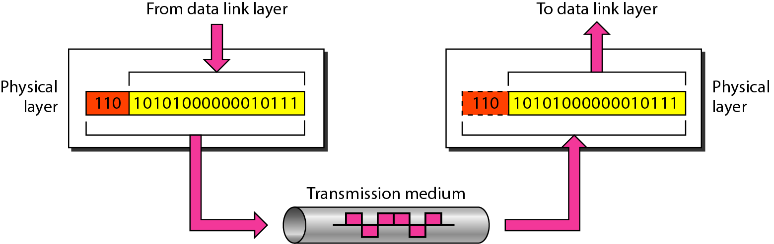
Figure 2.5 Physical layer

Slide 36
Note
The physical layer is responsible for movements of
individual bits from one hop (node) to the next.

Slide 37
Duties of Physical Layer
Physical Characteristics of interfaces and medium
Representation of bits
Data rate
Synchronization of bits
Line configuration
Physical topology
Transmission modes

Slide 38
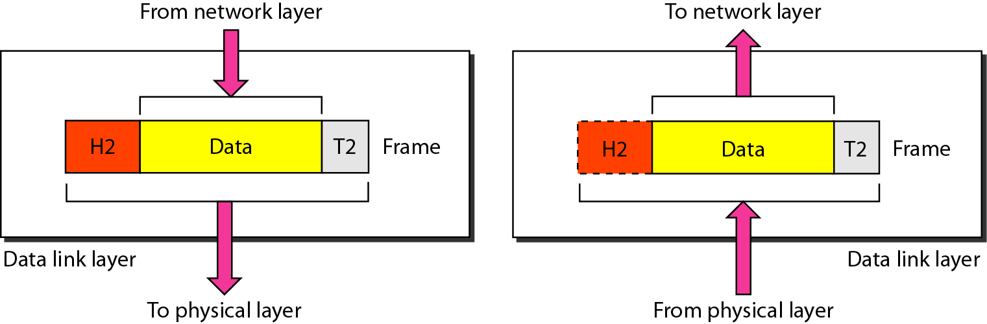
Figure 2.6 Data link layer

Slide 39
Note
The data link layer is responsible for moving frames from one hop (node) to the next.

Slide 40
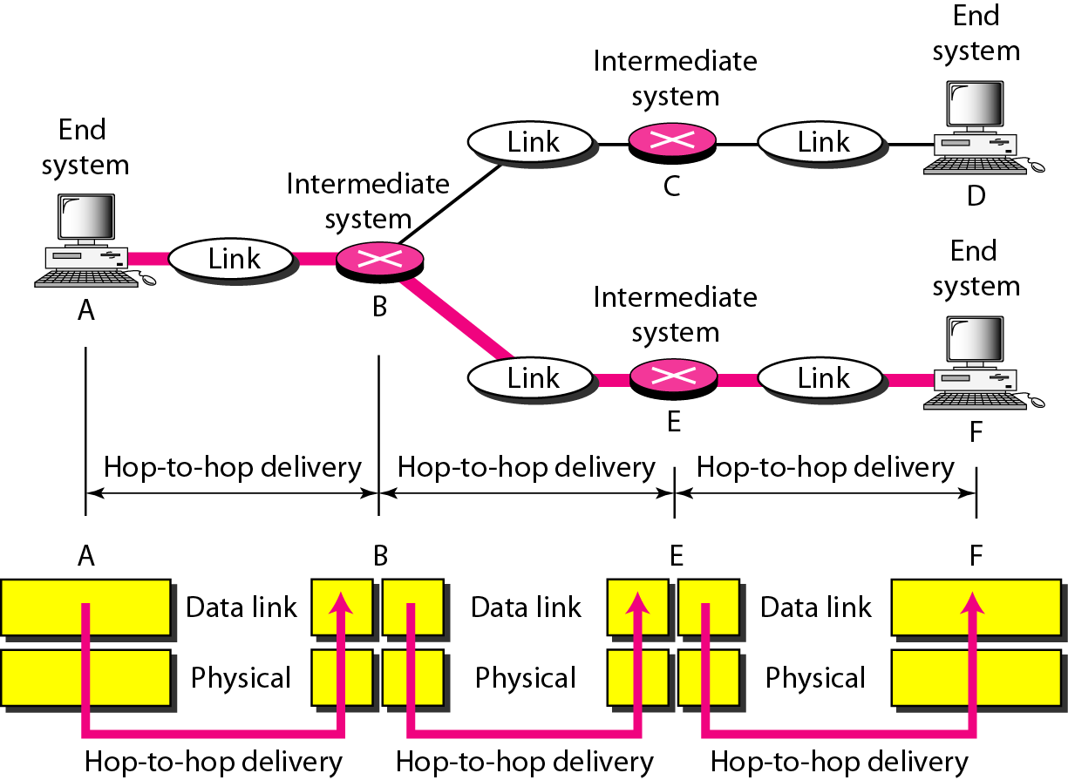
Figure 2.7 Hop-to-hop delivery

Slide 41
Duties of Data Link Layer
Framing
Physical addressing
Flow control
Error Control
Access Control

Slide 42
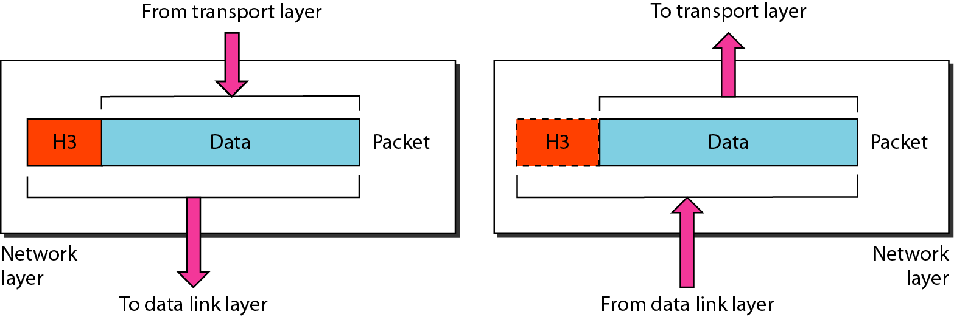
Figure 2.8 Network layer

Slide 43
Note
The network layer is responsible for the delivery of individual packets from
the source host to the destination host.

Slide 44
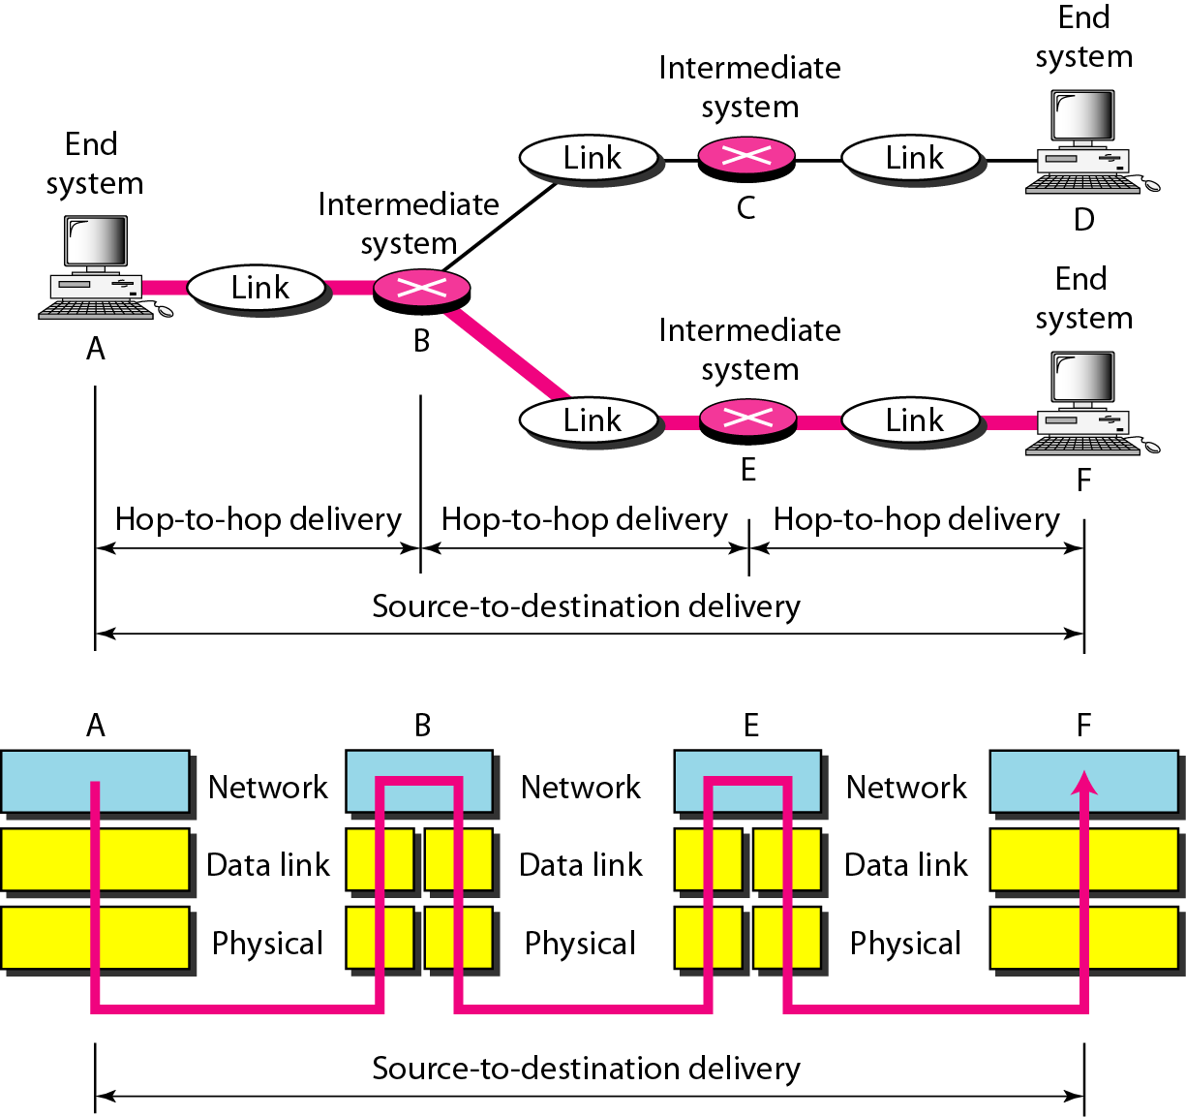
Figure 2.9 Source-to-destination delivery

Slide 45
Duties of Network Layer
Logical Addresssing
Routing

Slide 46
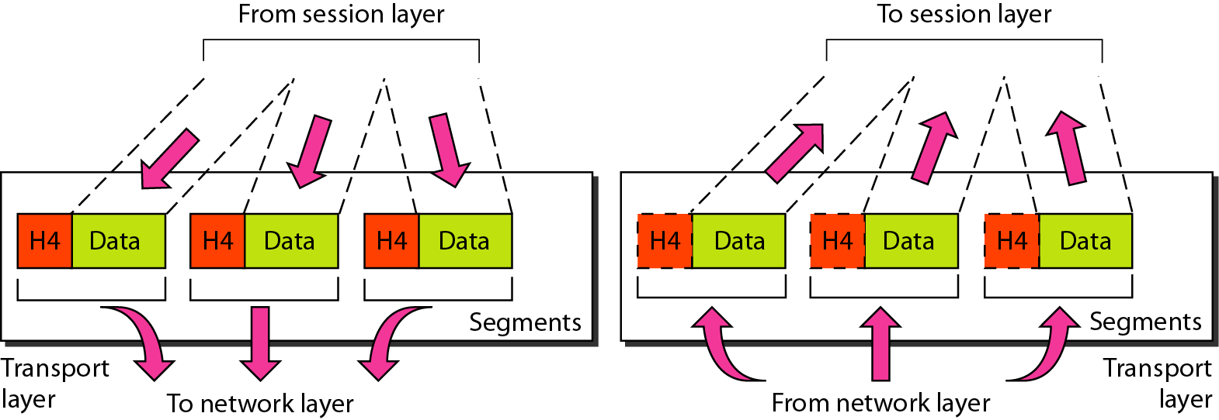
Figure 2.10 Transport layer

Slide 47
Note
The transport layer is responsible for the delivery of a message from one process to another.

Slide 48
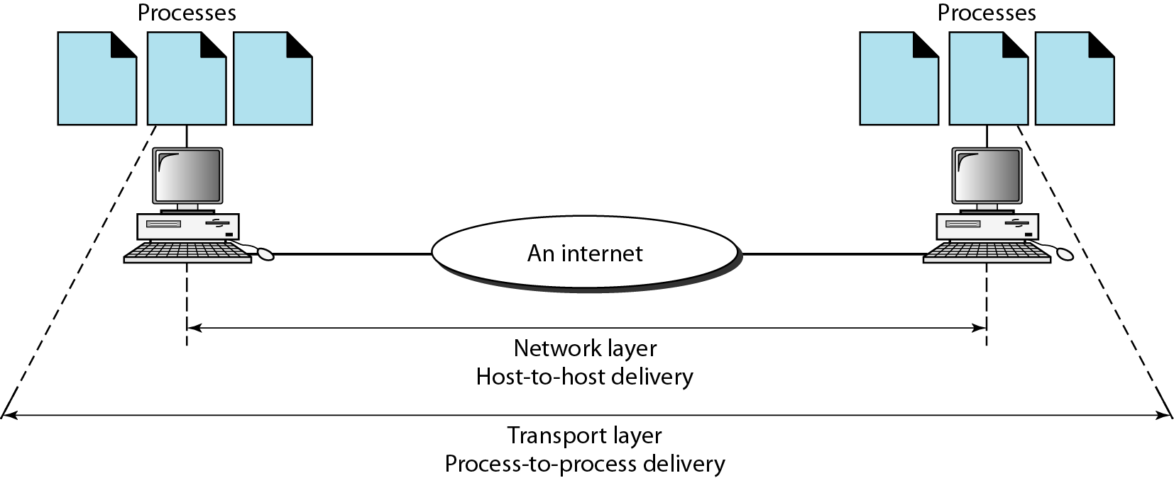
Figure 2.11 Reliable process-to-process delivery of a message

Slide 49
Duties of Transport Layer
Service point addressing
Segmentation and reassembly
Connection control
Flow control
Error control

Slide 50
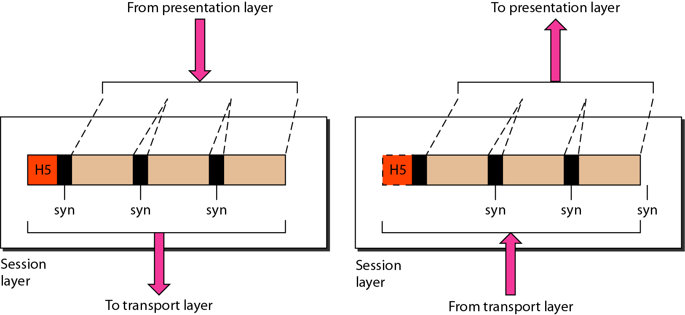
Figure 2.12 Session layer

Slide 51
Note
The session layer is responsible for dialog control and synchronization.

Slide 52
Duties of Session Layer
Dialog Control
Synchronization points

Slide 53
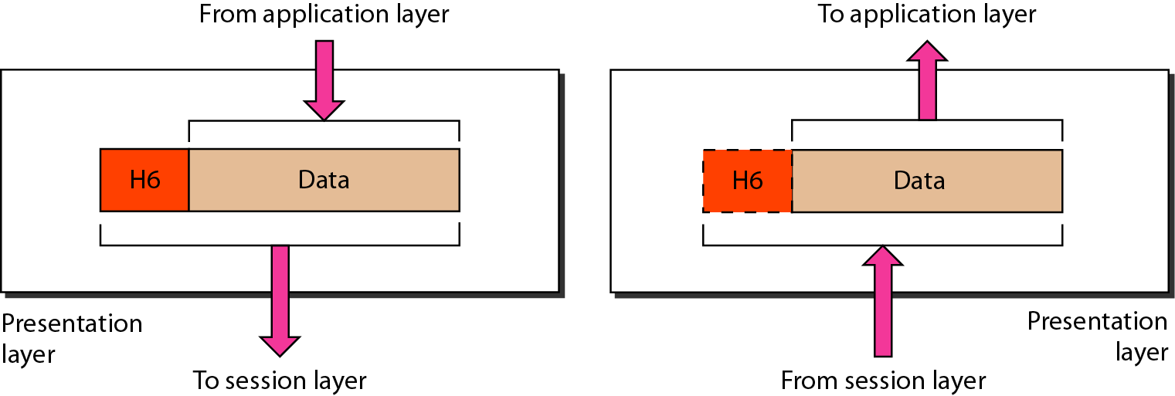
Figure 2.13 Presentation layer

Slide 54
Note
The presentation layer is responsible for translation, compression, and encryption.

Slide 55
Duties of Presentation Layer
Translation
Encryption
Compression

Slide 56
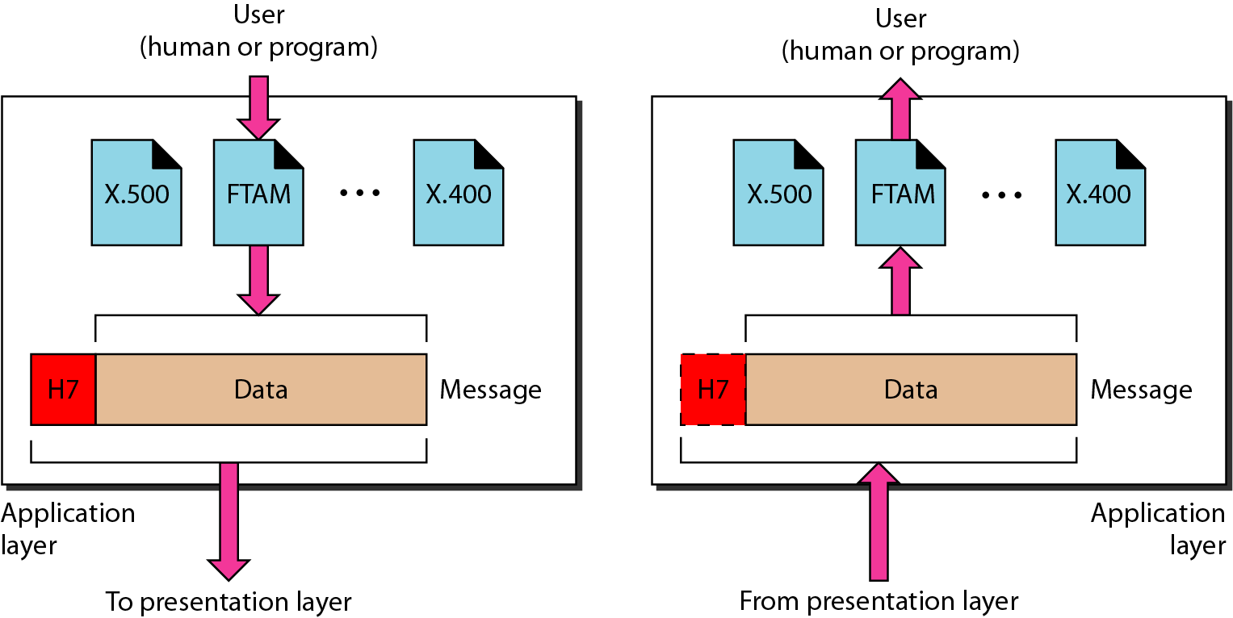
Figure 2.14 Application layer

Slide 57
Note
The application layer is responsible for providing services to the user.

Slide 58
Duties of Application Layer
Network virtual terminal
File transfer, access and management
Mail services
Directory services

Slide 59
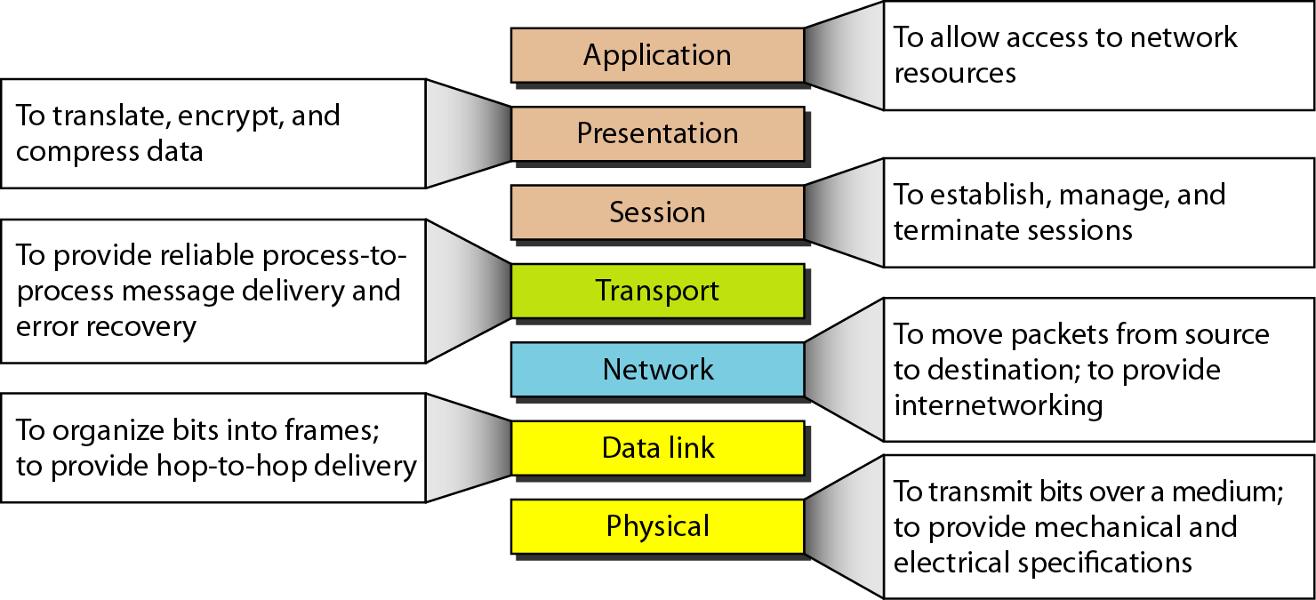
Figure 2.15 Summary of layers

Slide 60
2-4 TCP/IP PROTOCOL SUITE
The layers in the TCP/IP protocol suite do not exactly match those in the OSI model. The original TCP/IP protocol suite was defined as having four layers: host-to-network, internet, transport, and application. However, when TCP/IP is compared to OSI, we can say that the TCP/IP protocol suite is made of five layers: physical, data link, network, transport, and application.
Topics discussed in this section:
Physical and Data Link Layers Network Layer Transport Layer
Application Layer

Slide 61
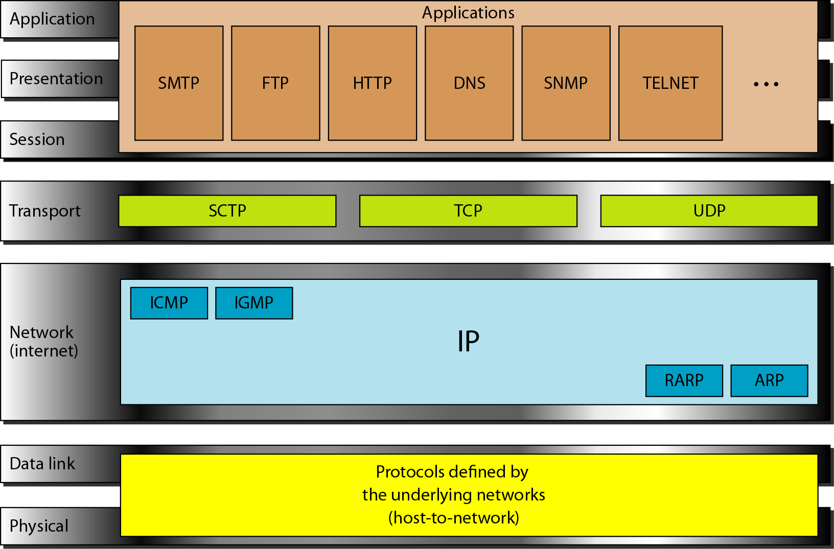
Figure 2.16 TCP/IP and OSI model

Slide 62
2-5 ADDRESSING
Four levels of addresses are used in an internet employing the TCP/IP protocols: physical, logical, port, and specific.
Topics discussed in this section:
Physical Addresses Logical Addresses Port Addresses Specific Addresses

Slide 63
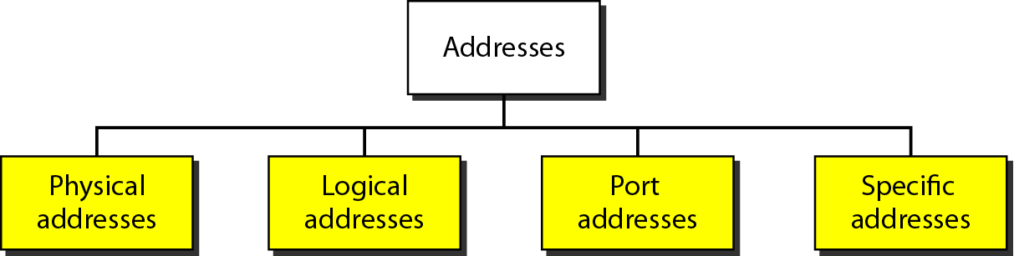
Figure 2.17 Addresses in TCP/IP

Slide 64
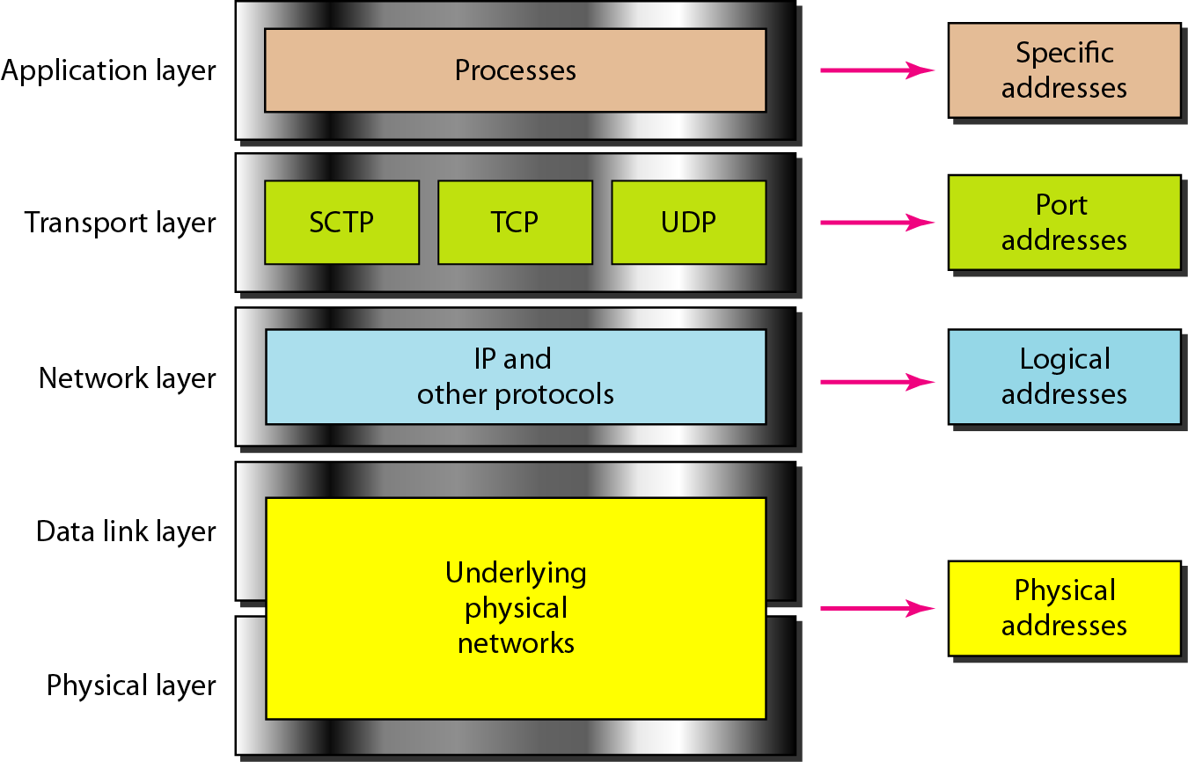
Figure 2.18 Relationship of layers and addresses in TCP/IP

Slide 65
Example 2.1
In Figure 2.19 a node with physical address 10 sends a frame to a node with physical address 87. The two nodes are connected by a link (bus topology LAN). As the figure shows, the computer with physical address 10 is the sender, and the computer with physical address 87 is the receiver.

Slide 66
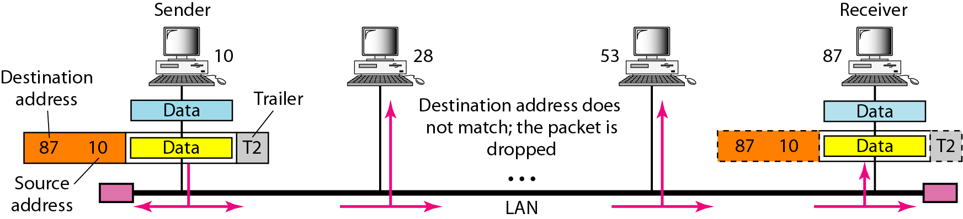
Figure 2.19 Physical addresses

Slide 67
Example 2.2
As we will see in Chapter 13, most local-area networks use a 48-bit (6-byte) physical address written as 12 hexadecimal digits; every byte (2 hexadecimal digits) is separated by a colon, as shown below:
07:01:02:01:2C:4B
A 6-byte (12 hexadecimal digits) physical address.

Slide 68
Example 2.3
Figure 2.20 shows a part of an internet with two routers connecting three LANs. Each device (computer or router) has a pair of addresses (logical and physical) for each connection. In this case, each computer is connected to only one link and therefore has only one pair of addresses. Each router, however, is connected to three networks (only two are shown in the figure). So each router has three pairs of addresses, one for each connection.

Slide 69
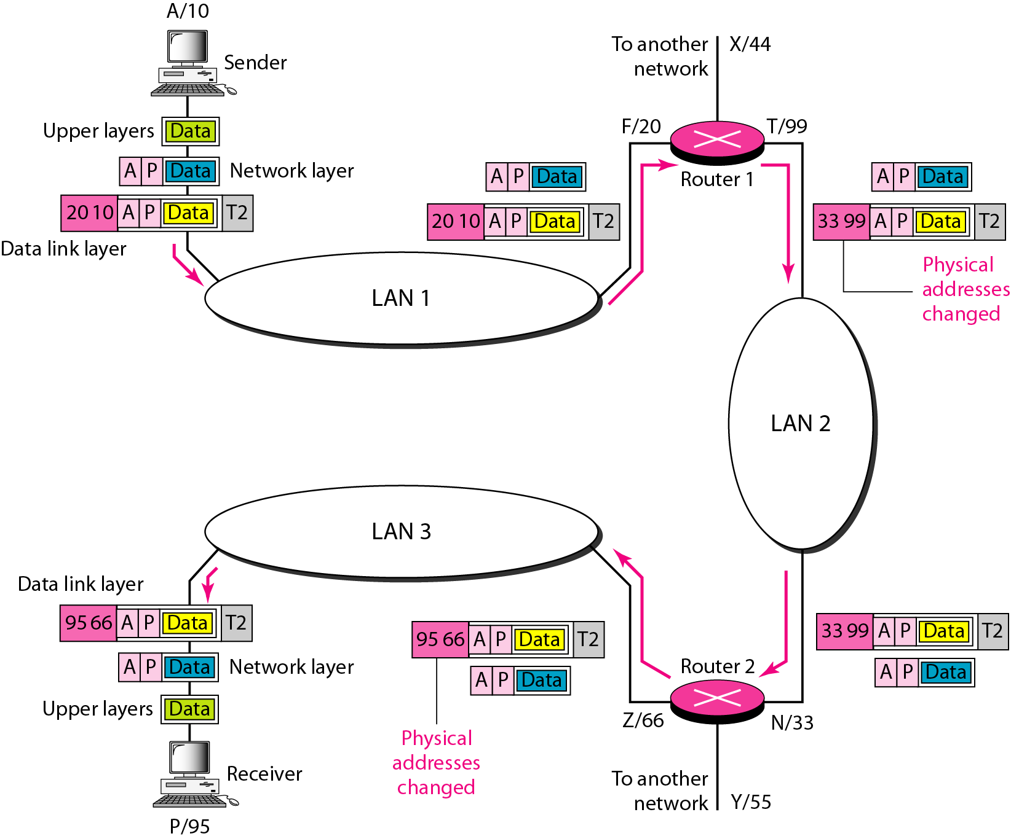
Figure 2.20 IP addresses

Slide 70
Example 2.4
Figure 2.21 shows two computers communicating via the Internet. The sending computer is running three processes at this time with port addresses a, b, and c. The receiving computer is running two processes at this time with port addresses j and k. Process a in the sending computer needs to communicate with process j in the receiving computer. Note that although physical addresses change from hop to hop, logical and port addresses remain the same from the source to destination.

Slide 71
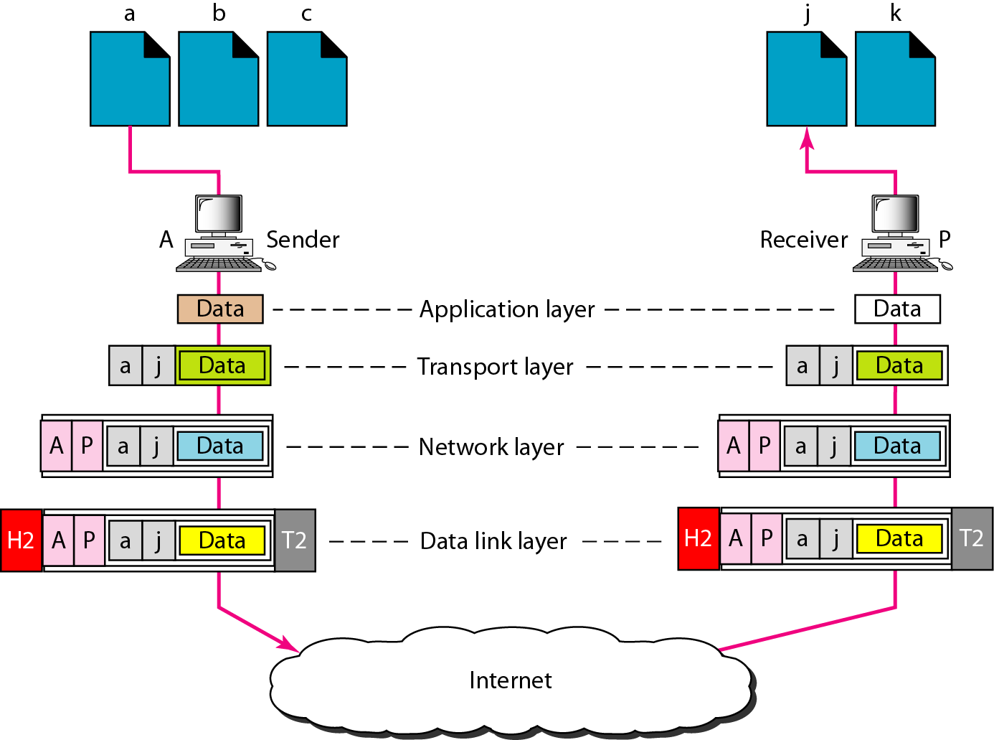
Figure 2.21 Port addresses

Slide 72
Note
The physical addresses will change from hop to hop,
but the logical addresses usually remain the same.

Slide 73
Example 2.5
As we will see in Chapter 23, a port address is a 16-bit address represented by one decimal number as shown.
753
A 16-bit port address represented as one single number.

Slide 74
Note
The physical addresses change from hop to hop,
but the logical and port addresses usually remain the same.

